Slide 1
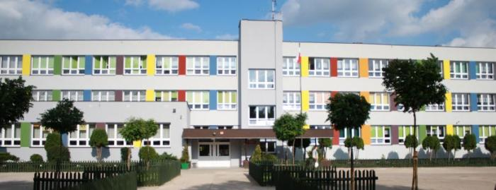
From One Cent to One Euro
Primary School no.19 in Bialystok, Poland

Slide 2
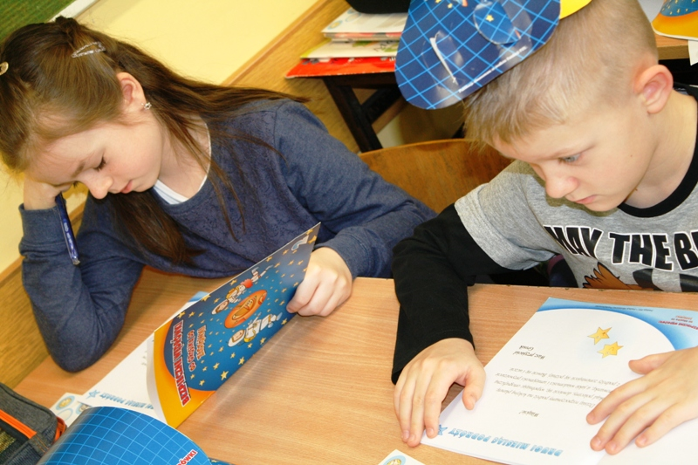
From One Cent to one Euro is a project for students aged 8 and 9 years old. It was started in 2007 by Polish
Insurance Company (PZU) and
Young Entrepreneurship Foundation.

Slide 3
Within two last years of the project we will learn
how to count money
how to manage money
how adults earn money
understand the value of work
how to save money
how to plan the shopping
understand the influence of adverts on our choices
how to help others in need
where to keep money safely
what it means to be rich, poor
what banks are for
how banks work

Slide 4
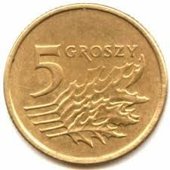
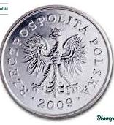
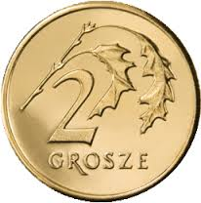
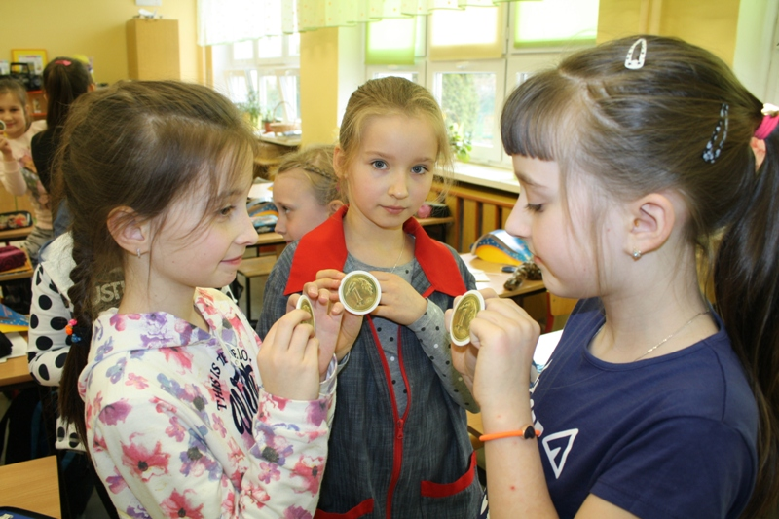
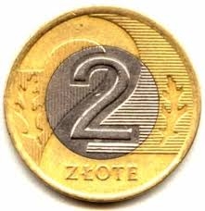
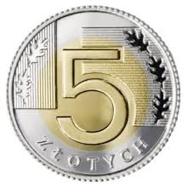
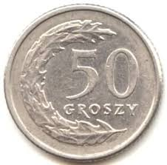
Are you ready for a ride?
Let’s get started!
We are on the planet Cent – which is Grosz in Polish. We are learning about banknotes and coins, what is head what is tail in our coins. Do you know?

Slide 5
We always learn …

Slide 6
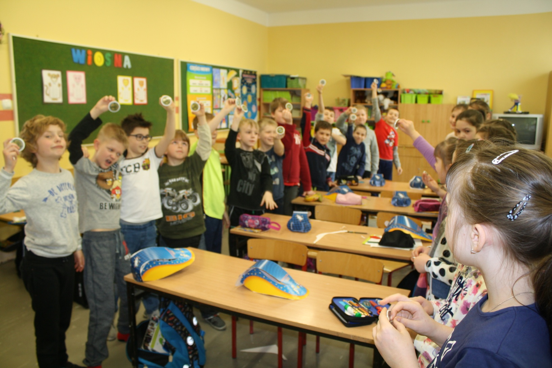
… and play!

Slide 7
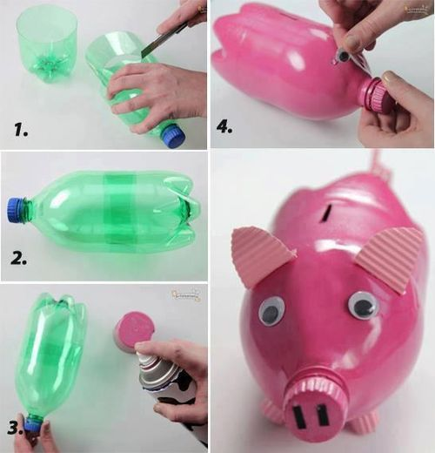
We are on the planets Wallet and Piggy Bank
Students visit imaginary planets and do many cross -curricular activities. They learn maths, they do crafts, they learn about safety and environment. Today they made a paper origami wallet where you can keep small coins. We learned how adults earn money and if children can go to work.
Than we designed our favourite piggy banks and learn how to save money. Many of us didn’t have any savings , now we have some and some big plans what to spend the money on…

Slide 8
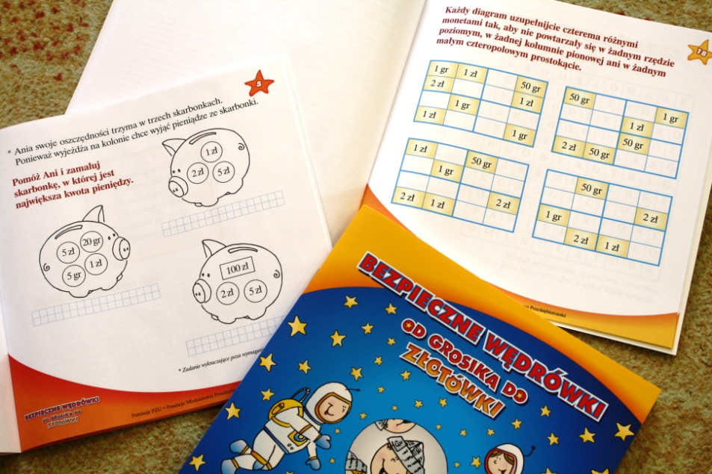
We have activity books to write in and do many interesting exercises like riddles and sudoku.

Slide 9
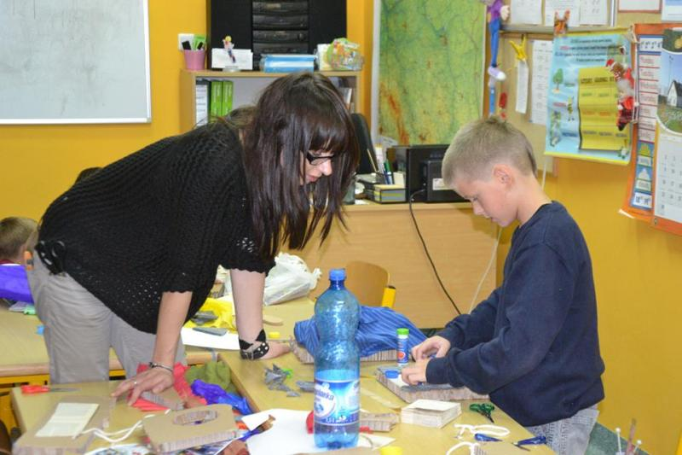
We are on the planet Advertisement.
We landed on the next planet Advertisement , which is very very big and colourful. We learned all about it and realised it has a big influence on our choices while doing the shopping. We worked in groups and we made our own ads of our favourite products.

Slide 10
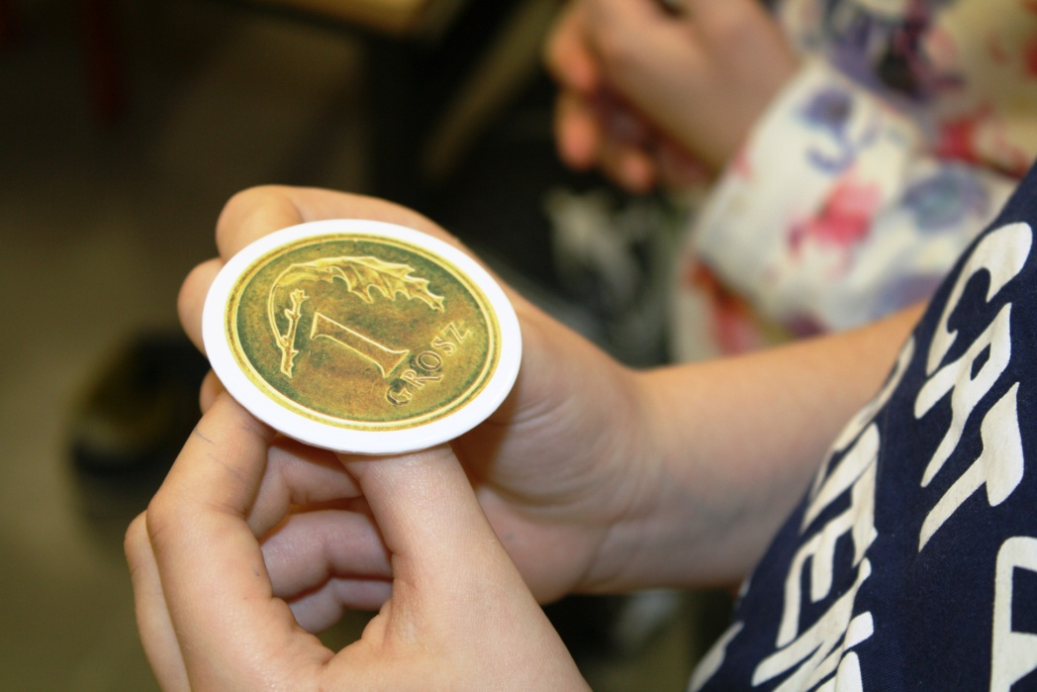
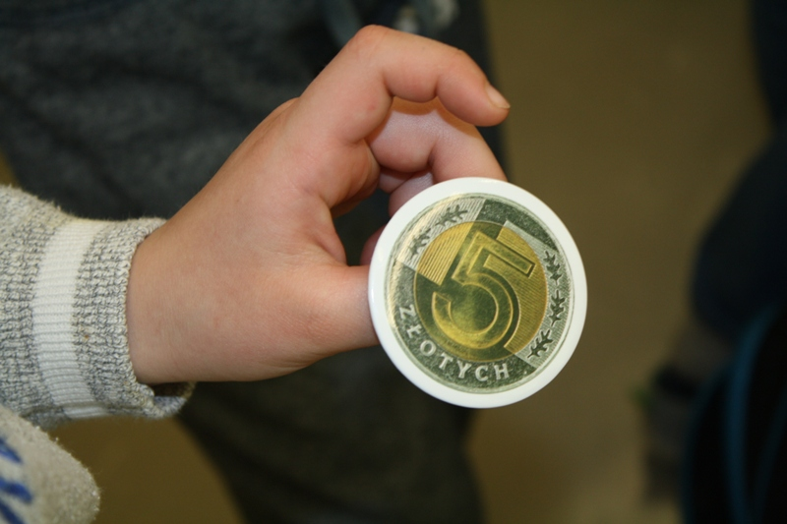
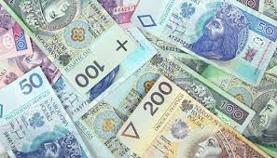

Slide 11
We had fun and learned a lot!

